Slide 1
Community of Practice
Roadmap Workshop
Goal of this workshop
Consider the needs and capacities of CoP members
Improve efficiency of Communities of practice
Clarify a roadmap that increase the chances of results and effective value of Community activities

Slide 2

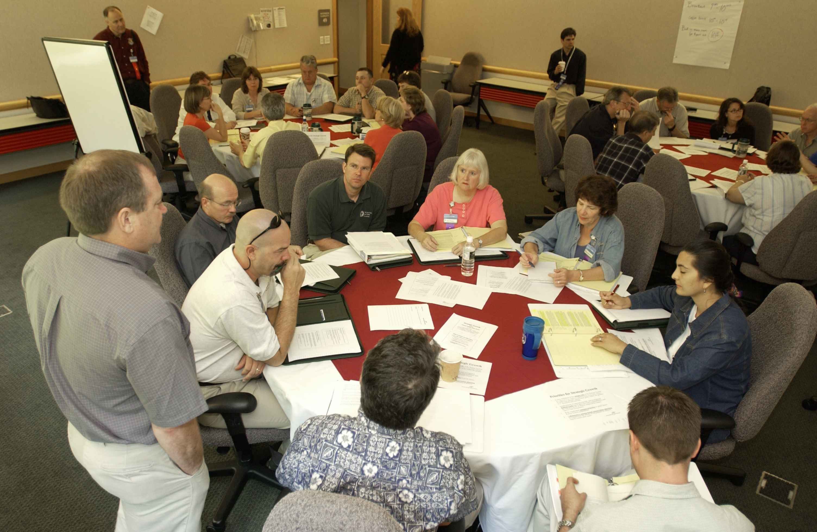

CoP roadmap workshop Work assumptions
This workshop assumes that the goal of a Corporate Community of Practice is to generate positive impact (mastery of practices, or at least implementation of it) outside of the Community context : during the job, with other people who are not from the Community, etc.
For example, if a Corporate Community of practice trains its members into a new method of communication or a new technology, the goal would be that members use this method or technology in their work and not only between Community members.
Also, this workshop assumes that not all practices are so easy to implement that any member would be ready to implement a practice “just after viewing it”. Some practices would need more than just presentations for members to do it by themselves out of Community context.
Therefore, this workshop intends to help Community members find the most relevant and feasible format of support to ensure implementation outside of Community context.
Time of member with the Community
Assumption :
Goal of a CoP is to help implement practices outside of Community context

Slide 3

Community of Practice roadmap workshop

Slide 4
For whom and why this Workshop?
Who is it for?
Communities of Practice (CoP) leaders (who define CoP roadmap
Learning Communities who share the same challenge
For which situations ?
Situation 1 : CoP is launching and wants to set up a consistent roadmap
Situation 2 : CoP is challenged on its value, despite a high number of shared practices, members need to get effective on-field results
*CoP = Community of Practice

Slide 5
Presentation of the workshop steps (optional)
1. Goal and explanation of the workshop Explain why this workshop in the Community of practice (show the problem, the cause, and the workshop)
2. Prioritize list of practices From the most to the least important to implement to the least.
Try to identify a top 3 (at least).
This part is optional if you already have prioritized practices.
3. For each practice, clarify its feasibility
For the top 3 practices, identify what level of support most members need, and what Community contributors can do about it.
If a practice is unfeasible, select another one from the top practices
5. Imagine a global roadmap with all practices
Organize the learning paths about your top 3 practices in an unified roadmap
(You can check CoP roadmap patterns if needed)
4. Imagine a Learning Path for the practice
For each practice of the top 3 feasible practice, clarify a specific chain of activities

Slide 6
Workshop organization
Location Physical or remote (prepare a virtual wall and a discussion room if in remote)
To prepare before A list of practices to work on in the Community.
(Optional) A list of ideas of activities of different levels
(Optional) A list of timeslots for Community moments
Participants Members of Communities of Practice who know what learning a practice means
Participants should include a minimum number of experienced potential contributors to make this workshop interesting.

Slide 7
Favorable & not favorable conditions
This workshop is easier when Members have past experiences in learning practices and implementing it during their job, knowing the difficulties
This workshop becomes very difficult when List of practices are not ready yet
Participants do not feel ready or legitimate to choose activities and roadmap

Slide 8


Step 1 : Explanation about workshop goals
15 min

Slide 9


Practice and Communities of practice Vocabulary and assumptions
A professional PRACTICE is here defined as
A set of actions one can DO within some conditions
Brings value, utility or satisfaction in a context of work, leading to RESULTS
Something that is generic enough to be done and repeated by different people in their own context
A professional practice is NOT :
A general theme
A question
A set of actions without any impact (or intention of impact) on professional life
A set of actions that only one or a very few persons have the opportunity to reproduce
Something that was done once in a very specific context and cannot be done anymore
A professional COMMUNITY OF PRACTICE is here defined as :
A set of individuals who organize themselves as a Community in some activities in order to learn, practice, and ultimately improve RESULTS
A MEMBER of a professional Community of practice is here defined as :
A person who attends activities of Community of Practice in order to bring practices to professional life and lead to on-field results.

Slide 10
The untold story of members in some Communities of practice
Time of member with the Community
Community leaders
Member
Here is a new practice
Here is a new practice
Here is a new practice
Here is a new practice
Why are members leaving and are less engaged ?
Why do we have difficulties in measuring impact of Communities ?
Great, I will try to apply the first practice !
But I did not even have time to apply the previo...
I may need help to apply it for real in my job and…
There is no point going again !!
Accumulation of practice sharing activities does not always mean increasing the chances for practices to spread outside of Community context

Slide 11
CoP roadmap workshop CoP Member experience : Path about a given practice
DISCOVER the practice
I know that “I did not know this practice”, and open my mind to its existence in other contexts
I can picture an example of practicing or practitioner
I know enough about this practice to be interested
DIGEST the practice
I can compare the practice to what I know and my own past references, making it my own
I can estimate its usefulness and relevance for me and for now
I start understanding (not just knowing) what it means to practice it myself (within a safe environment and with repetitions)
DEPLOY the practice
I face the challenges of practicing in my own environment (job context), with its specificities
I take some hindsight on the specific value of the practice within my own context
I become autonomous in implementation of the practice
Member of Community of practice about a given practice

Slide 12
CoP roadmap workshop CoP Member experience : Path about a given practice
DISCOVER PRACTICE
DIGEST PRACTICE
DEPLOY PRACTICE
I can do this part by myself
I may need the assistance of a Community for this part
I may need the assistance of a Community for this part
Member of Community of practice about a given practice

Slide 13

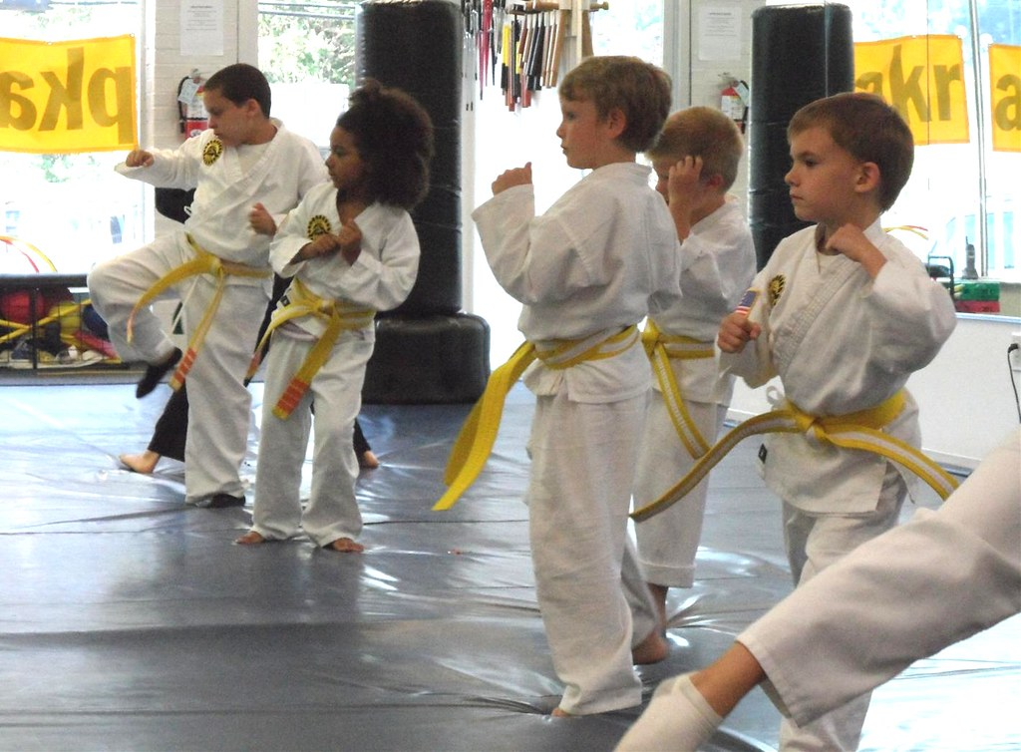

CoP roadmap workshop Levels to which a Community of Practice can support a practice CoP Member experience
A Community of Practice can host many types of activities, each one having many effects, but mostly impacting one of the DDD (Discover, Digest, Deploy) phase.
These activities in turn can be categorized into 3 main levels of activities.
Show & Hope level activities
Train & Hope level activities
Train & support on-field level activities
DISCOVER
DIGEST
DEPLOY
Member of Community of practice

Slide 14
CoP roadmap workshop Examples of activities
Show & Hope level
Train & Hope level
Train & support on-field level
🗣️Organization of feedback sessions by members, for discovery purpose
🔥Presentation of inspirational examples
🖥️Coding Dojos / Practicing dojos
🎒Tutorials & exercises (may be online)
🤼Workshops to practice together
🏫Learning Paths
🗣️Talks from advanced practitioners to other practitioners to perfect their training.
🕵️Shadowing of experts and live feedback or post-feedback
❓Answering specific requests
🆘Experts hotline or clinic timeslots
🫴Co-development sessions
👁️Review deliverables that are used on-field
🗣️Talks from advanced practitioners to practitioners in deployment phase

Slide 15
CoP roadmap workshop Members estimate their needs
Show & Hope level
Train & Hope level
Train & support on-field level
The goal of the CoP roadmap workshop is to avoid relying on pure assumptions on members’ autonomy, by using collective expression and decision on “what part to do in the Community of Practice to get results” for each practice, within capacity of contributors.
Practice A
What level of support MOST members need to get to results
What the Community contributors can provide

Slide 16
CoP roadmap workshop Roadmap is based on requirements and contribution capacities
Show & Hope level
Train & Hope level
Train & support on-field level
From the knowledge of autonomy capacity and contribution capacity of the Community on a given practice (here example practice A), members can then deduce a roadmap of real activities.
What level of support MOST members need to get to results
Practice A
What the Community contributors can provide
🗣️ Presentation by an experienced member
🖥️Training session on practice
🖥️Training session on practice (Repeat)
Roadmap for Practice A

Slide 17
CoP roadmap workshop Different requirements lead to different roadmaps
Show & Hope level
Train & Hope level
Train & support on-field level
Different practices can have different requirements, and lead to different roadmaps adapted to most members.
Practice B
What level of support MOST members need to get to results
What the Community contributors can provide
🖥️Training session on practice
🖥️Training session on practice (Repeat)
🕵️Shadowing by expert members in implementation cases
🫴Co-dev sessions about implementation challenges
Roadmap for Practice B

Slide 18
CoP roadmap workshop Levels to which a Community of Practice can support a practice CoP Member experience : Usual assumption of CoP leaders
Show & Hope level
Train & Hope level
Train & support on-field level
If the Community cannot provide what members need to get to results, even if contributors can contribute, there is not much interest in occupying Community members time with useless activities.
What level of support MOST members need to get to results
Practice C
What the Community contributors can provide
Roadmap for Practice C

Slide 19

Workshop Material

Slide 20


Step 2 : Practice prioritization
10 min
Practice A
Practice E
Which practices do you consider the most interesting in terms of results ?
Vote
(example : 3 for each person)
Practice A
10 votes
Extract top 3 most voted practices
Practice B
Practice F
Practice B
9 votes
Practice C
Practice G
Practice C
8 votes
Practice D
Practice H

Slide 21
Step 3 : Members’ Needs to get results and contributors’ capacities
5 min explanation
+
3 min per practice
As a Community member, what are your needs of Community support to get to results ?
Inform (up to 3 per person if you need the 3 levels).
Show & Hope level
Train & Hope level
Train & support on-field level
In order to get results, I would need Community activities to DISCOVER this practice
In order to get results, I would need Community activities to DIGEST this practice
In order to get results, I would need Community activities to help me DEPLOY this practice
Practice A
As a Community contributor, what help can you provide to other members ? (you both have skills and enough availability)
Inform (up to 3 per contributor if you can help on 3 levels)
I can help other members DISCOVER the practice (give feedback, show basic examples, inspire, …)
I can help other members DIGEST the practice (organize, find or support training, …)
I can help other members to DEPLOY the practice
(support on-field, answer to deployment questions…)

Slide 22
Step 3 : Needs and capacities for results
Show & Hope level
Train & Hope level
Train & support on-field level
Show & Hope level
Train & Hope level
Train & support on-field level
Practice A
Members’ needs
Practice B
Members’ needs
Capacity of contributors
Capacity of contributors
Case number 1:
Capacity of Community contributors exceeds most members’ needs on the practice
Jump to next step
Case number 2:
Most members’ needs on the practice exceed capacity of contributors
Put this practice aside, repeat the exercise on another practice from the top priorities
If there are no more interesting practices in the prioritized list
Try to find external contributors
Try to find more practices
If nothing works, review your goals as a Community of practice or even the interest of building a Community if you have only members but no contributors.

Slide 23
Step 4 : Establish a Learning Path for a given practice
15 min per practice
Show & Hope level
Train & Hope level
Train & support on-field level
Contributors can propose various activities of different levels (only necessary levels) and non-contributing members can react on the interest of it
EXAMPLES OF ACTIVITIES
🗣️Organization of feedback sessions by members, for discovery purpose
🔥Presentation of inspirational examples
EXAMPLES OF ACTIVITIES
🖥️Coding Dojos / Practicing dojos
🎒Tutorials & exercises (may be online)
🤼Workshops to practice together
🏫Learning Paths
🗣️Talks from advanced practitioners to other practitioners to perfect their training.
EXAMPLES OF ACTIVITIES
🕵️Shadowing of experts and live feedback or post-feedback
❓Answering specific requests
🆘Experts hotline or clinic timeslots
🫴Co-development sessions
👁️Review deliverables that are used on-field
🗣️Talks from advanced practitioners to practitioners in deployment phase
Practice A
🗣️ Presentation by Alice (experienced)
🖥️Training session on practice organized by Bob
🖥️Training session on practice organized by Bob
🕵️Organization of shadowing by Alice & Bob of members who implement
🫴Co-dev sessions about difficulties in implementation on-field
Together, members choose the activities and set up a Learning Path. You do not need to set dates at this point.

Slide 24
Step 5 : Establish a unified roadmap
25 min
 | Session 1 | Session 2 | Session 3 | Session 4 | Session 5 | Session 6 | Session 7 | Session 8 | Session 9
Practice A | Presentation by Alice | Training session by Bob | Co-Dev session by Charlie
Practice B |  |  |  | Feedback presentation by Charlie | Training by Charlie | Shadowing by Charlie (expert in practice B)
Practice C |  |  |  |  |  |  | Example talk by Dick | Practice C Dojo by Alice | On-field support clinic with Alice
Get to this step when you have the top 3 practices.
If you already have the timeslots for your Community (session 1, 2, …), try to integrate your top 3 learning paths in your timeslots.
Choose your strategy well : You can use the CoP roadmap patterns if needed.
If you did not have time to produce 3 learning paths, either start a roadmap with what you have or wait for next sessions to produce the 3 learning paths

Slide 25
Optional help for Step 5 : CoP Roadmap patterns
In the cases of Community of Practice with multiple practices in target, there are multiple ways to define a roadmap, with elements of various levels. This section studies several usual patterns of CoP roadmaps.

Slide 26


CoP roadmap workshop Simplification for pattern definition
 | Session 1 | Session 2 | Session 3
Practice A
 | Session 1
Practice A
Practice B
Practice C
Session 1 | Session 2 | Session 3
“Consumers” type members may leave
Roadmaps of Communities of practice are represented in a set of sessions (timeslots).
The visual representations below are the same as Gantt charts : a horizontal timeline and activities as blocks below.
When activities happen simultaneously, it means that Community members split into subgroups. Therefore, there are single-group roadmap patterns, and multi-group roadmap patterns
For visual simplification, for most of patterns below, only one session per type of activity has been represented on the example hereby, but it can of course be extended in this pattern (for example, 1 session of show and hope activity, 4 of train and hope activities, 3 of train and support on-field activity.
For visual simplification also, all 3 types of activities are represented for each practice.
When a pattern explicitly needs several sessions of the same type, it is represented as such in the example.
In most cases below, only three patterns are represented, as 3 is enough to visually demonstrate the key principle behind each pattern.
When a pattern explicitly needs more practices, it is represented with more than 3 practices.
When a key moment or key event of a given pattern is to be noticed, a small arrow is represented in the timeline.

Slide 27
Cop Roadmap workshop Single-group roadmap pattern : practices in series
In the single-group roadmap pattern “practices in series”, practices are worked one-by-one by all members, on the various steps of maturity up to implementation on-field.
Advantages :
Low context switching, increasing chances
Faster concentration and results
All members are together, increasing chances to reach of critical mass threshold
Drawbacks :
Less consideration for individual practice preferences
Slower general discovery and feeling of novelty
If timing of opportunity of deployment is not during timeslots for support of deployment, opportunity can be lost
Favorable conditions for this pattern:
Members know the practices enough to make strong choices
Pressure for fast proof of value from members or from stakeholders
Less pressure on regular novelty than on results
Practices can be deployed (anytime) without strong conditions on timing
 | Session 1 | Session 2 | Session 3 | Session 4 | Session 5 | Session 6 | Session 7 | Session 8 | Session 9
Practice A
Practice B
Practice C
First proofs of Community value on-field

Slide 28
Cop Roadmap workshop Single-group roadmap pattern : Seasonal
In the seasonal roadmap pattern, all the activities of a same level are performed together, before getting to activities of the next level, establishing “seasons”. Members are together in one single group.
Advantages :
Low required investment at the beginning, higher chances of engagement in the unknown
Members have an overview of all top 3 practices before training starts
Leaves more time to prepare digesting and deployment sessions
Drawbacks :
First season can induce a passive behavior and habits
If activities about a same practice are too far from each other, there might be risk on going low on the forgetting curve
First on-field support activities and easy proofs of Community value happen late
Favorable conditions for this pattern:
Participants do not know the practices at all or not enough for a strong choice
Contributors require time to prepare training sessions
Low level of requests of on-field support and low pressure from sponsors
 | Session 1 | Session 2 | Session 3 | Session 4 | Session 5 | Session 6 | Session 7 | Session 8 | Session 9
Practice A
Practice B
Practice C
Show & hope season
Train & hope season
Train & support on-field season
“Consumers” type members may leave

Slide 29
Cop Roadmap workshop Multi-group roadmap pattern : Subgroups by practice
In the subgroups by practices pattern, members are split into subgroups dedicated to practices.
Advantages :
Members can join in practicing what they want very early in the roadmap
Contributors do not have to wait and can engage in the Community early
Less pressure on size of groups, especially for non-scalable activities
Drawbacks :
Members who are interested in several practices take one and miss the others
Requires more contributors’ simultaneous capacity
Less mutualization effects due to smaller numbers with split groups
Favorable conditions for this pattern:
Members have enough superficial understanding of practices to select a subgroup
Practices are different enough to trigger a strong choice of members
 | Session 1 | Session 2 | Session 3 | Session 4 | Session 5 | Session 6 | Session 7 | Session 8 | Session 9
Practice A
Practice B
Practice C
Subgroup selection

Slide 30
Cop Roadmap workshop Multi-group roadmap pattern : Show then decide (of subgroups by practice)
In the inspiration “Show then decide” pattern, members participate in a single group to all “Show & Hope” activities before splitting subgroups by practice.
Advantages :
Balances advantages of subgroup by practices pattern and seasonal pattern.
Common show & hope season help members decide of a subgroup
Drawbacks :
Balances drawbacks of subgroup by practices pattern and seasonal pattern
Members with strong preferences need to wait for the end of show & hope season before starting
Favorable conditions for this pattern:
Members do not know the practices enough to choose a subgroup in the beginning of the roadmap
 | Session 1 | Session 2 | Session 3 | Session 4 | Session 5 | Session 6 | Session 7 | Session 8 | Session 9
Practice A
Practice B
Practice C
Show & hope season
Subgroup selection

Slide 31


Cop Roadmap workshop Multi-group roadmap pattern : Subgroups by level of maturity (per practice)
In the “subgroup by level of maturity”, members are split in subgroups by level of activities.
Advantages :
Members can spend time with others from their level, with less pressure to go faster or to slow down
More advanced members do not have to wait for activities adapted to their level
A same practice can be performed progressively
Drawbacks :
Members of different levels spend less time together
Pattern need more contributors, with continuous endeavor. Especially if goal is to work on more than one practice.
Either practice one practice for a long time (and wait for the others) or leave less time for more beginner practitioners to join.
Favorable conditions for this pattern:
Practice “train & support on field” activities take much more time than “show and hope activities”
One strong practice is chosen over the others
 | Session 1 | Session 2 | Session 3 | Session 4 | Session 5 | Session 6 | Session 7 | Session 8 | Session 9
Practice A
Practice B
Practice C
When show & hope activities are over or enough, members can join the subgroup of next level
When train & hope activities are over or enough, members can join the subgroup of next level
Subgroup selection

Slide 32

How to choose a roadmap that fits your Community of practice ?
It is important to remember that
There is no “perfect pattern” that fit all situations and only have advantages
With advantages of a pattern come the related drawbacks
Patterns are just simple theoretical forms that are easier to remember and share. Reality can be less easy.
Allow yourself to be operationally creative, not for the sake of creativity but in order to find a roadmap that fits your situation: do not limit yourself to listed patterns if none of them bring you satisfaction.
What to consider before choosing a pattern :
Here are at least 3 questions to ask yourself before choosing a roadmap pattern
How strong are the choices of practice of your members ? The stronger the choices, the less frustration in case of subgroups or in case of practices in series. Weaker choices would need show & hope seasons at least to p
What level of pressure on “first results on-field” ? A high level of pressure on getting quick wins will push towards practices in series or subgroups. Lower pressure open your choices to more patterns.
On which characteristics are your members very heterogeneous (levels, preferences, …) ? If your members are very heterogeneous, you have strong pressure either in creating subgroups or in designing activities that exploit heterogeneity while being satisfying for all (difficult to design).
How much time do your contributors need to prepare activities? Contributors may need time to prepare activities, some might not be available at some timeslots.

Slide 33
Organization

Slide 34
Overview of the workshop
🛠️Examples of uses and problems addressed
🎓Instructional Objectives
🎯Objectives
🧑Ideal audience
Software Community of Practice of the ABCDEF company has a collective kick-off in which they intend to establish the roadmap of their Community.
With a list of practices ready, they decide to use CoP roadmap workshop to measure their needs and capacities, then turn it into a roadmap.
At the end of this workshop, participants will have learnt :
That freestyle accumulation of practice sharing activities does not always mean effective practice implementation
How to build a roadmap for Communities of Practice
Roadmap of Community of Practice is established for top 3 practices
Participants should be members of a same Community of Practice and have enough decision power collectively to decide on roadmap.
Up to 20 participants, if there are more than 20 participants, they should be split into subgroups by practice.
🎤Short pitch (to be copied and pasted into the descriptions)
Topics not covered in this workshop
📅Logistics
💡Ideas for complements
How to increase the chances of effective learning in Communities of Practice (with effects) ? How to take into account differences in levels of members on potential practices ?
CoP roadmap workshop use collective information and collective decision to establish an adapted roadmap for Communities of practice.
How to prioritize topics
1h30
Virtual wall or physical wall with notes and writing material
Participants must be able to vote
#OSC Topics Mapping
Community Members Quadrant workshops
6 Community whys
Change Community Cycle

Slide 35

Facilitation

Slide 36
Before the workshop
Preparatory action | Why this action | Recommendations
Prepare a list of practices for the CoP | Without a list of practices to prioritize, the workshop has no point | Prepare a topic list before, and ask experienced members to list practices
Prepare timeslots for Community roadmap | Will be useful in step 5 | Discuss with members of reasonable availability for them
Make sure your community has enough contributors or at least external content to support some practices | Without contributors or content, no practices will be learnt | List potential contributors of your Community, contributors must be able to propose activities of learning of diffferent levels Discuss with these potential contributors beforehand
Make sure your Community targets effective results outside of the Community | If the Community of Practice goals are not implementation of practices on-field (during job or work moments) this workshop is useless | You can clarify the goals of your Community of Practice by using 6 Community whys (#OpenSeriousCommunity workshop)

Slide 37
During the workshop
Opening: Intro | Course of action Game rules, Narrative | Closing: Debriefing, Thanks...
15 minutes Step 1 : explanation of workshop goal Facilitator explains the goal of the workshop | 10 minutes. Step 2 : Practice prioritization Members vote on practices 5 minutes + 3 minutes per practice Step 3 : Needs and capacities of contributors For each practice, inform what are your needs as a members or your capacity to contribute as a contributor. 15 minutes per practice Step 4 : Learning path for contributors For each practice that is considered possible in the community, brainstorm a learning path that match needs. 25 minutes per practice Step 5 : Unified roadmap Take all the learning paths and decide of a roadmap for your Community | 5 minutes Plan next events (book timeslots) and communicate the roadmap to all members (including absent participants)
Total :
90 minutes

Slide 38





Special cases of facilitation
How to adapt if there are very few participants (number close to the minimum limit)
How to adapt if there are many participants (number close to the maximum limit)
How do you adapt if participants arrive at different times or in dribs and drabs?
If participants leave during the workshop, how do you deal with the remaining participants?
Make sure there are at least enough contributors and decision makers.
If you cannot get enough information about your members, you might build a roadmap that is not adapted to needs and within capacities.
You can try use asynchronous means (polls, etc.) to do
If you have many participants, good news is the fact that you will collect more relevant information for practice prioritization, needs and even contributing capacities.
You can make subgroups starting from Step 3.
Most important point is that arriving participants accept the prioritization of step 2.
They will have to rely on other participants to understand the different levels of step 3 and 4.
If a large majority arrives after step 1, it is best to repeat step 1 (explanation).
Participants should stay at least up to step 3 and contributors up to step 4.
Otherwise, postpone the second part of the meeting

Slide 39









Special cases of facilitation
What if the participants don't dare to take the risk of exposing their choices and preferences ?
How do we deal with criticism of the legitimacy of facilitators?
What if some people do not want to participate?
How can I feel more comfortable introducing myself as a facilitator?
If you explain the step 1 well enough, it would be against their own interest not to express their needs.
Facilitators do not have to master the topics or the practices, but the learning path of any practice in Community of Practice.
Facilitators should be at least accompanied with contributors who know some forms of learning activities of each level.
If members do not want to participate, it means that they are ok with whatever roadmap the CoP proposes.
It either means that they are so flexible that they could take any type of learning path (maybe do some parts by themselves), or that they would not engage in learning path anyway. In both these cases they are not an issue to the result of the workshop.
Strong recommendation is to learn well the part 1 before starting, and even read the additional information in the last section of this document.

Slide 40

Adaptation

Slide 41
Adaptation of the workshop
Version history
Version | Contributors | License | Comments
1.0 | Alexandre QUACH | CC-BY 4.0 | First version
Ideas for variants
Title of the variant or extension | Description
Asynchronous version of this workshop | This workshop could be performed asynchronously by using means for voting or proposing. An interesting extension would be ready to use forms to reproduce the workshop.

Slide 42














#OpenSeriousTemplate in brief What to add to make your serious game transferable
I imagine how to adapt this game
We know how to facilitate and co-facilitate this game!
I know when, why, with whom, and how to use this game to make it useful
I can play
NIV 1 CURIOUS(-SE): Pitch, promotional material, promotional images
NIV 2 PLAYER : Rules of the game, content of the game (cards, board, slides), FAQ, example, Observer grid
NIV 3 ECLAIREUR(-SE) : Pedagogical objectives, operational, problems addressed, use cases, subjects not covered, what to complete with, ideal audience, pre-requisites, help with promotion and post-event communication
LEVEL 4 CO-FACILITATOR: Co-facilitation/facilitation breakdown, suggested session length,
LEVEL 5 FACILITATOR: Animation tips, specific debriefing questions, difficult animation cases
LEVEL 6 CREATOR: Variant or extension ideas, reuse rights, version history
I want to play

Slide 43
Thank you
This workshop version is created by Komyu
Open up for Massive Co-operation
www.komyu.io

Slide 44
Additional explanations about CoP roadmap workshop

Slide 45
CoP roadmap workshop Levels to which a Community of Practice can support a practice CoP Member experience : Path about a given practice
There are different levels at which a member of Community of practice can take ownership of a practice from discovery to deployment.
Depending on the goal and the current level of the member for the given practice, there might be different needs. This member path can be called the DDD path (Discover, Digest, Deploy) in a Community of practice.
DISCOVER the practice
I know that “I did not know this practice”, and open my mind to its existence in other contexts
I can picture an example of practicing or practitioner
I know enough about this practice to be interested
DIGEST the practice
I can compare the practice to what I know and my own past references, making it my own
I can estimate its usefulness and relevance for me and for now
I start understanding (not just knowing) what it means to practice it myself (within a safe environment and with repetitions)
DEPLOY the practice
I face the challenges of practicing in my own environment (job context), with its specificities
I take some hindsight on the specific value of the practice within my own context
I become autonomous in implementation of the practice
Member of Community of practice about a given practice

Slide 46
CoP roadmap workshop CoP Member experience : Path about a given practice
DISCOVER PRACTICE
DIGEST PRACTICE
DEPLOY PRACTICE
I can do this part by myself
I may need the assistance of a Community for this part
I may need the assistance of a Community for this part
Member of Community of practice about a given practice
A member may be able to do some parts of the path by him/herself, while needing assistance from the Community for the other parts.
Depending on many factors (ability to take initiative, trust in oneself, exposure to content, willingness to try, etc.), a member may do more parts of the path by him/herself or less.

Slide 47
CoP roadmap workshop Levels to which a Community of Practice can support a practice CoP Member experience : Usual assumption of CoP leaders
Given the easiness and scalability of “Show and hope” activities (mostly presentations that only requires a short availability of contributors), a Community of Practice leaders can take the assumption that most members can do the “Digest & Deploy” part by themselves, and therefore deduce that Community should focus only on discovery of practices.
DISCOVER
DIGEST
DEPLOY
“I may need the assistance of a Community for this part”
“I can do this part by myself“
“I can do this part by myself“
Let’s organize mostly
inspirational presentations

Slide 48
CoP roadmap workshop Levels to which a Community of Practice can support a practice CoP Member experience : Case of wrong assumptions by CoP leaders
If Community of Practice leaders make the wrong assumptions on capacity of autonomy of members to discover, digest and deploy practice, it might end up doing the wrong activities (that are either too few or too much)
I would really need more assistance to apply this practice. Otherwise, it is almost like I’m wasting my time.
I don’t really need the Community to do so much. I can do a large part of it on my own. I’m wasting my time.
Members are VERY autonomous, let’s show practices only and hope
Members are not autonomous at all, let’s do the full path
Overestimation of autonomy of members
Underestimation of autonomy of members

Slide 49
CoP roadmap workshop Levels to which a Community of Practice can support a practice
A community of practice can support its members up to various levels
Show & Hope level
Train & Hope level
Train & support on-field level
Community shows the practices (member tells a story, presents…) to members without practicing together. Then, Community hopes that they will take initiative to train themselves, assimilate, try to implement when in real-life stress situations.
Community organizes the collective training of the practice until assimilation. Then Community hopes that members will be able to implement practice implementation on field (in real-life stress situations).
Community organizes the collective training of the practice until assimilation, then supports on-field (in real-life stress situations) implementation up to the point of independence.

Slide 50
CoP roadmap workshop Levels to which a Community of Practice can support a practice
Show & Hope level
Train & Hope level
Train & support on-field level
Best for easy casual practices (relatively to members level), for resourceful members with high initiative or for lowest capacity
Advantages
Low effort of contribution
Showing is easy to scale
Best for medium difficulty practices without lots of opportunities to apply
Advantages
Active learning increase chances of appropriation
Best for valuable practices in which failure can be damaging
Advantages
Community follows practice up to real on-field value
Drawbacks
Appropriation level can be low, and so is real effect
Drawbacks
Substantial effort of contribution if training is not ready yet
Drawbacks
Very high effort of contribution and prep. time

Slide 51
CoP roadmap workshop Examples of positive impact Measurements
Show & Hope level
Train & Hope level
Train & support on-field level
🌡️Measure attendance & satisfaction about the showing sessions and hope for the best about implementation on field
🎓Measure skill improvement (certifications, variation of levels, etc.) and hope for the best about implementation on-field.
📈Measure result on-field (achieved objectives, solved issues, quality of deliverables, quality of execution…)

